Slide 1

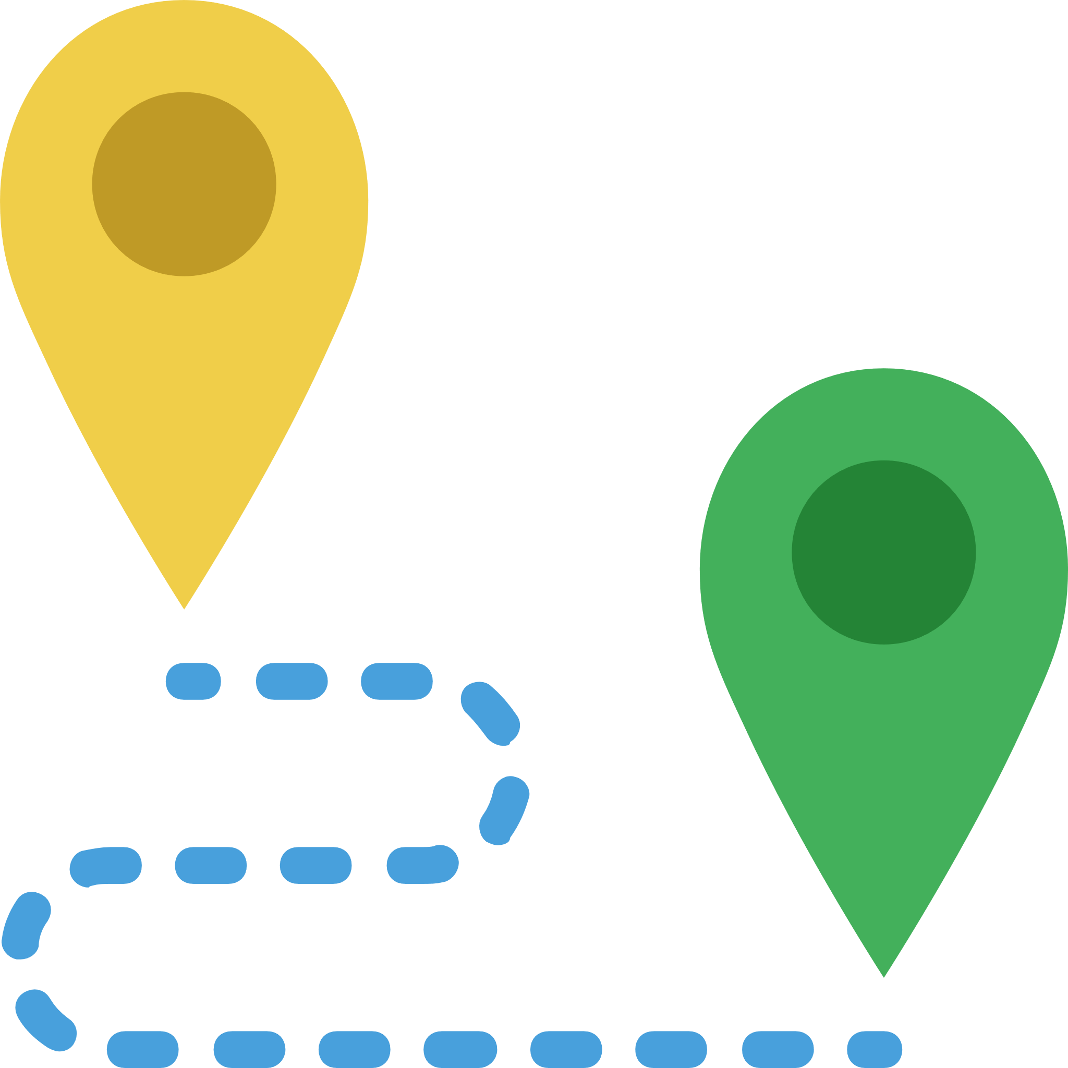


Route Planning Algorithm will be initialized and using the way points the user will be guided to the destination
Extraction
of
Features
Way points will be marked by the user of the mobile application
Features will be scanned from the camera, initialised in the mobile application
The features and the way points will be feed in the database in JSON format

